Slide 1

Disclosing Domestic Servants Registries
as Linked Open Data
Richard L. Zijdeman (IISG, University of Stirling)
CLARIAH
November 24, 2022, Utrecht, NL
Stirling, Scotland

Slide 2
Problem 1: representation of women’s work
in historical sources
Underregistration of work activities
Unrecognized activities
Only allowed in certain occupations

Slide 3
Problem 2: representation of local archives
Local archives do most of the hard work:
preserving data, digitizing data, data entry
Get no credit for any of it from ‘us’ (not even ‘clicks’)
Making it more difficult to secure funding
(Also bad for ‘us’)

Slide 4
Exception: domestic servant registers
Registration of mainly women
Available for multiple decades
Available in multiple countries
Detailed info on age, religion and migration
(But indeed limited to a number of occupations)

Slide 5

The Next Web
https://www.ted.com/talks/tim_berners_lee_on_the_next_web

Slide 6
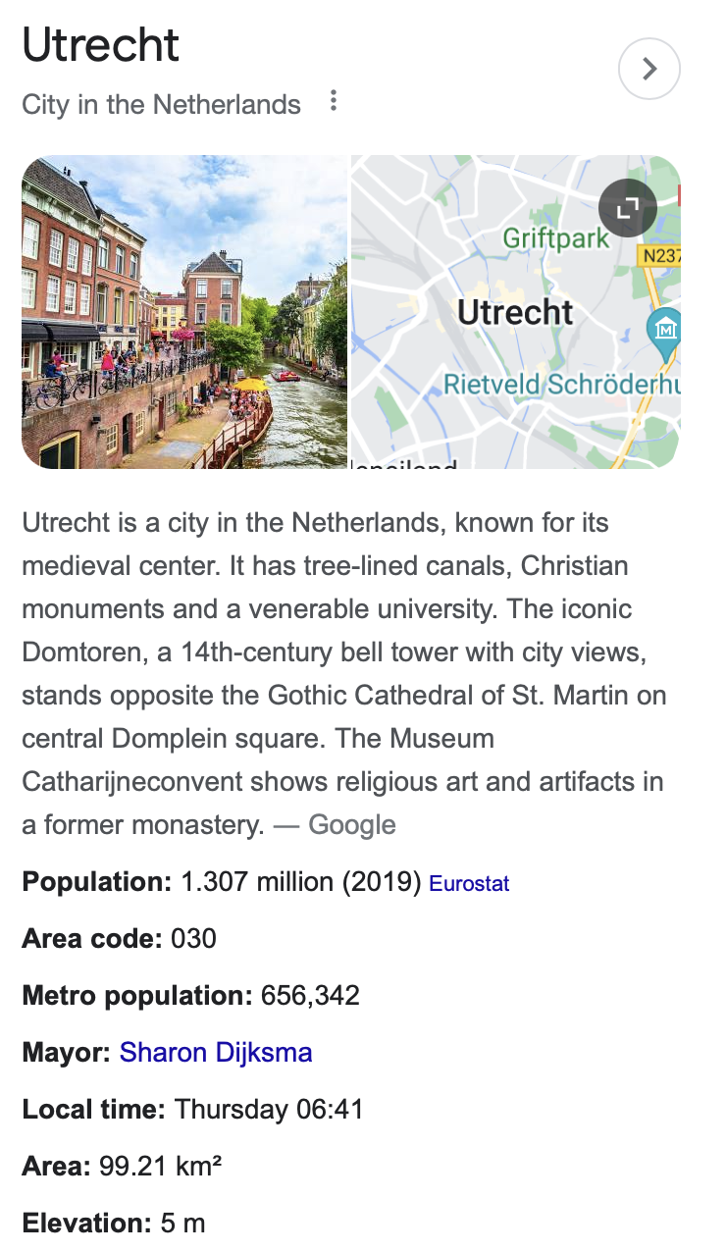
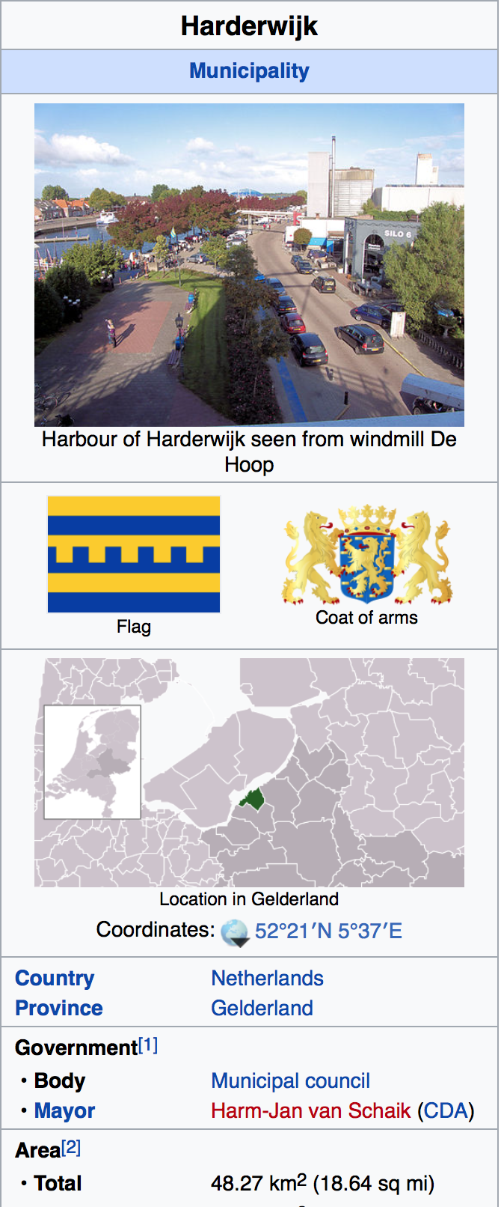
You’ve probably used it already!

Slide 7
From old school
to 5-star Linked Data
LINK TO OTHER
DATA TO PROVIDE
CONTEXT
USING W3C STANDARDS
RDF / SPARQL
IN NON-PROPRIETARY
FORMAT
AS MACHINE READABLE
STRUCTURED DATA
PUT IT ON THE WEB

Slide 8
Linked Data (RDF)
Represent data facts as URI’s:
Unique ID, that’s preferably also a URL (retrievable via the Web)
“Utrecht” -> https://dbpedia.org/page/Utrecht

Slide 9
Linked Data (RDF)
Structure facts in triples (tripartite statements):
ID | birthPlace
1 | Utrecht
… | …
<id1>
<hasBirthPlace>
<Utrecht>
<https://mydata.org/id/1>
<https://schema.org/birthPlace>
<https://dbpedia.org/page/Utrecht>

Slide 10

Data
Dienstboden (‘domestic service’) register 1888-1909
[1873-1880, 1880-1887, 1906-1919]
Data entry by volunteers of the Historical Association ‘Herderwich’
Data provided by Historical Knowledge Center Harderwijk
Basic cleaning (mainly of dates and incorrect fields)
N_unique = 1519 (N_raw=1880)

Slide 11
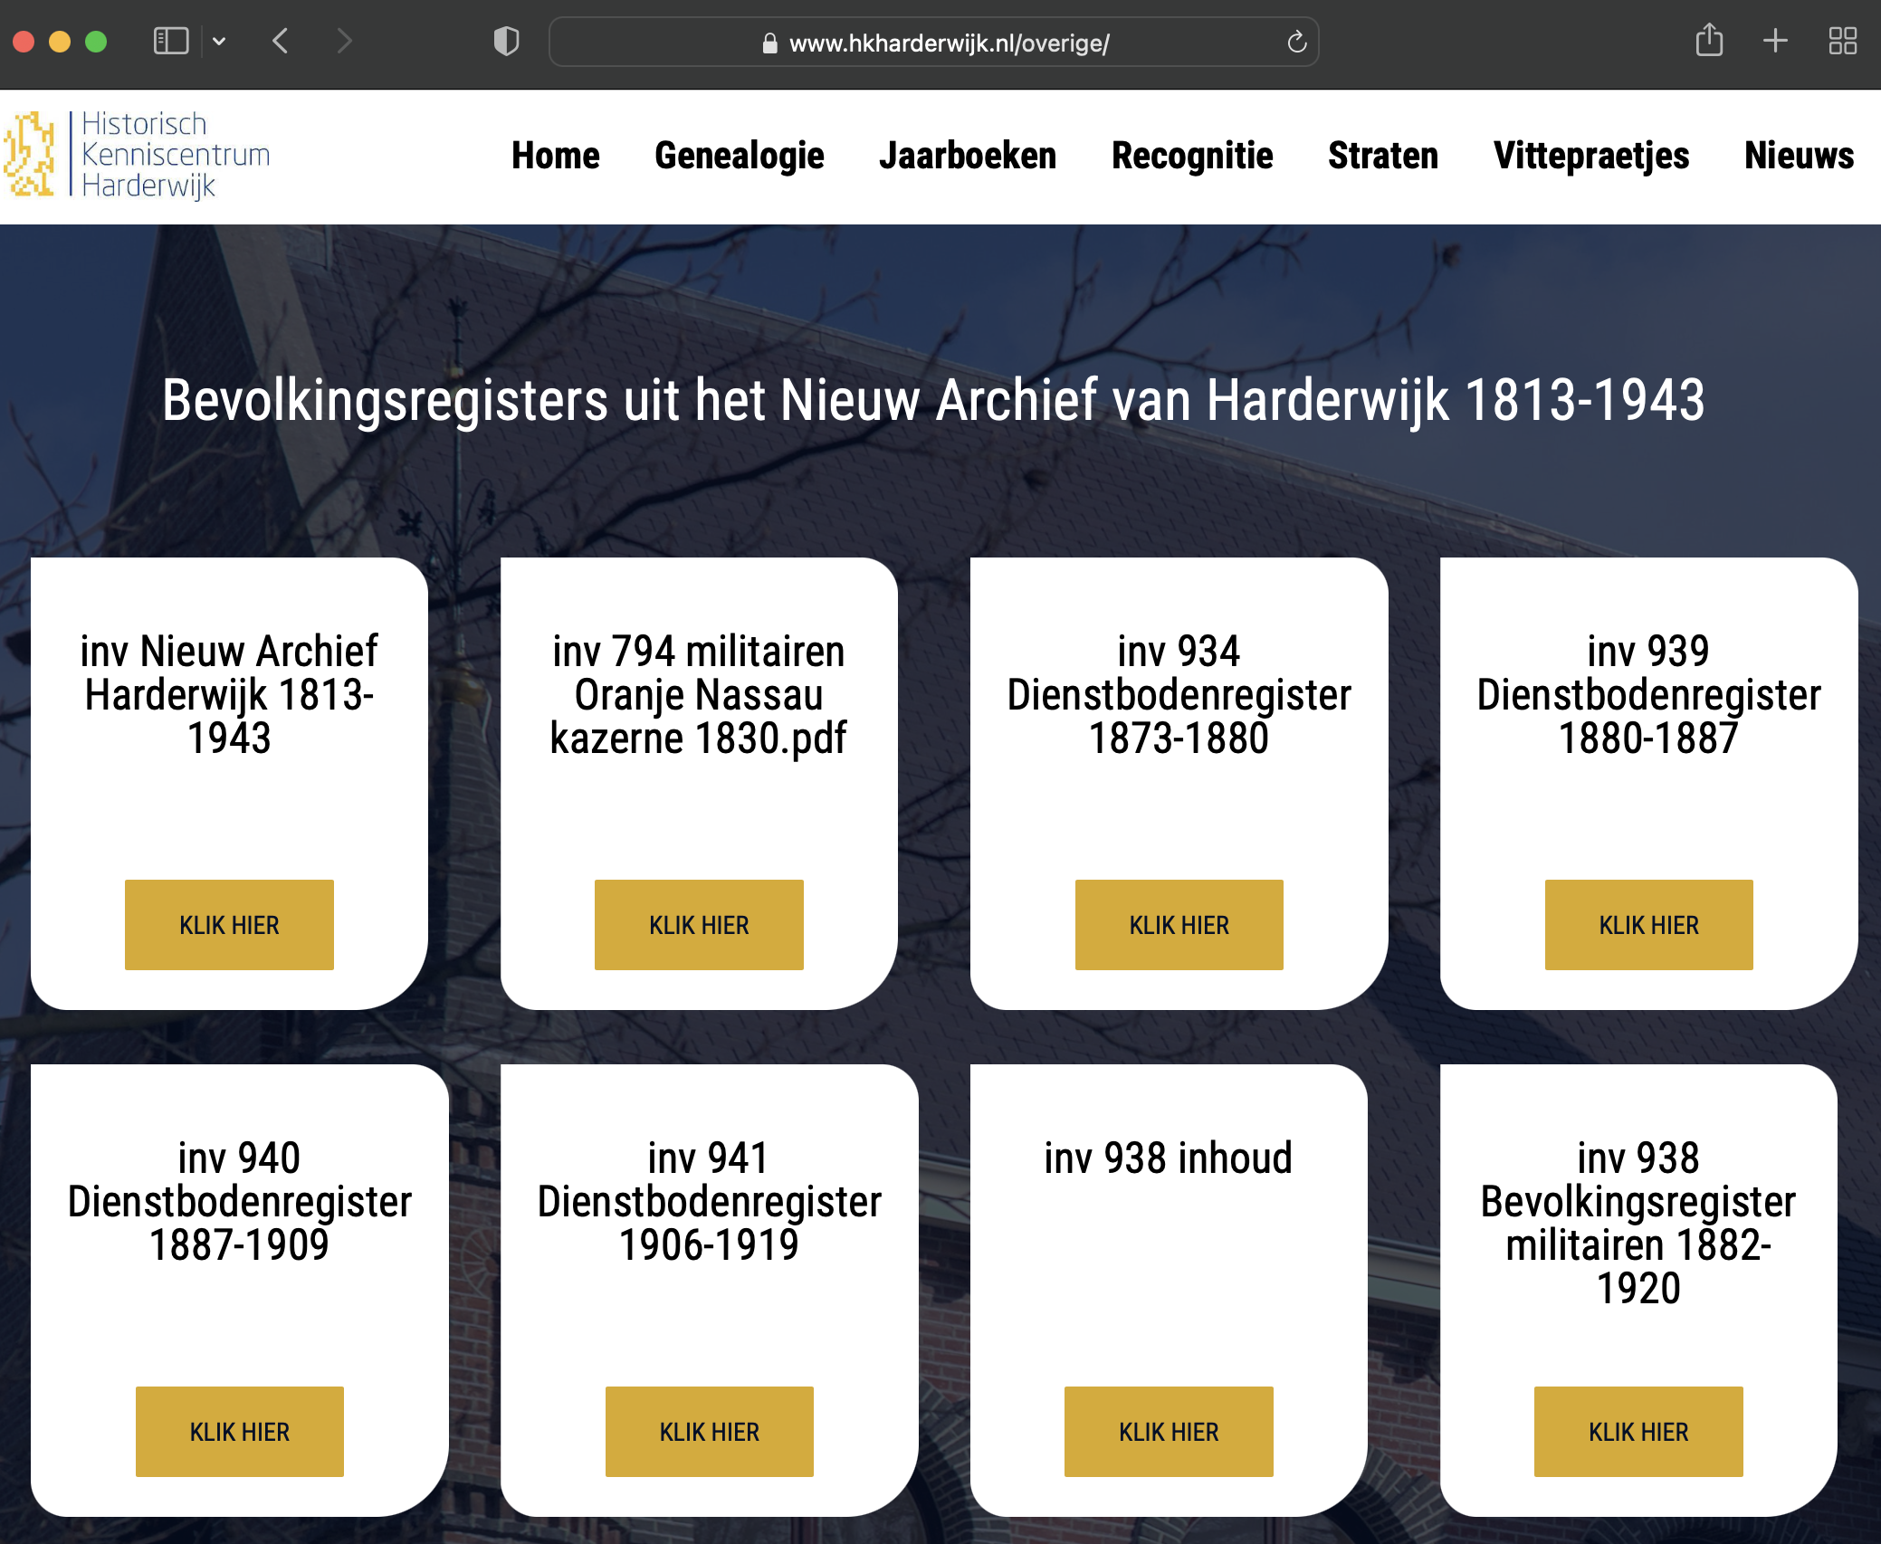
Historisch
Kenniscentrum
Harderwijk
https://www.hkharderwijk.nl/overige/

Slide 12
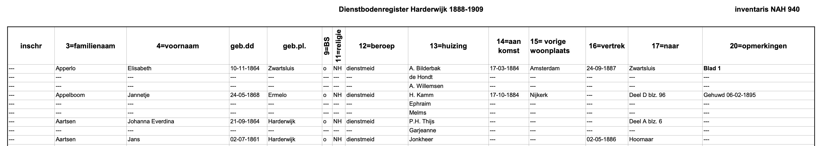
Variables
familyName
givenName
dateOfBirth
placeOfBirth
(civil status)
religion
(occupation)
hostName
comments
placeComingFrom
dateOfArrival
placeLeavingTo
dateOfDeparture

Slide 13
Data conversion
Data converted using a tool: CoW (Meroño-Peñuela et al. 2019)
Takes a csv as argument
Automatically creates RDF and a ‘recipe’ for the conversion
You can manually alter the recipe (like an R/Python script)
Recipe available via: https://github.com/rlzijdeman/hkh-maids

Slide 14
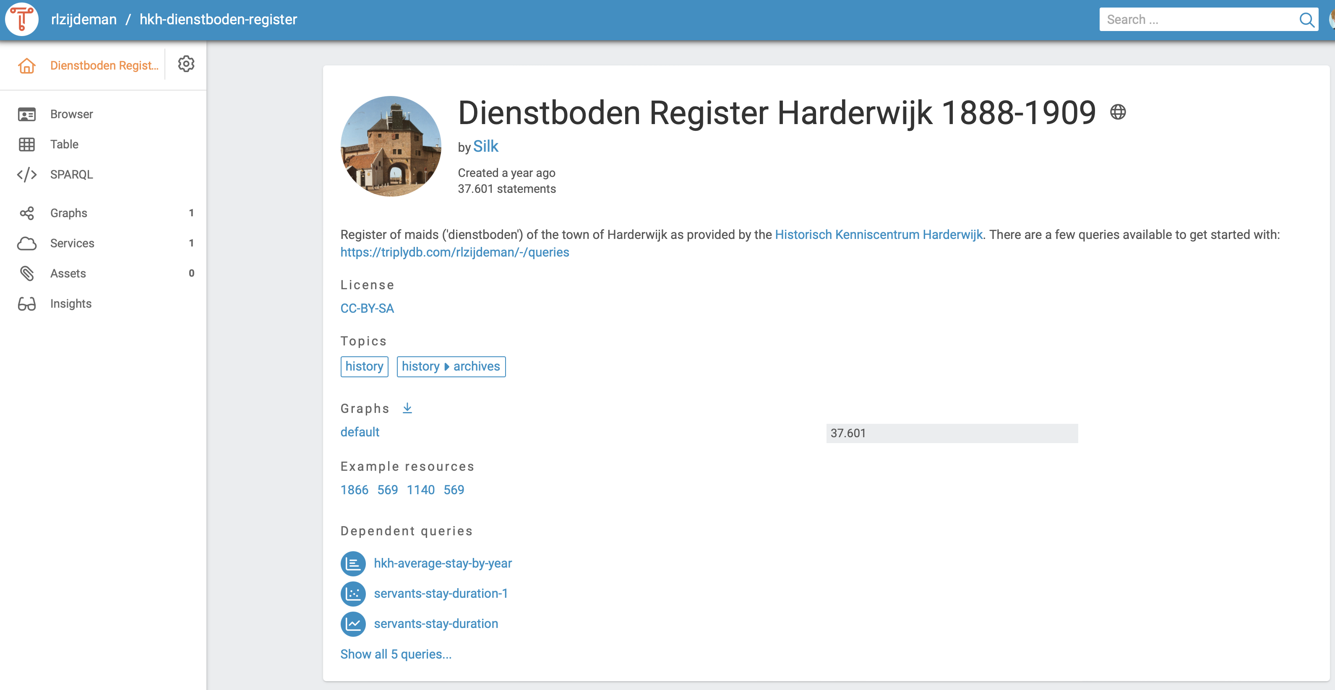
Data ‘live’ available
Hosted via Triply’s triple store:
https://triplydb.com/rlzijdeman/hkh-dienstboden-register

Slide 15
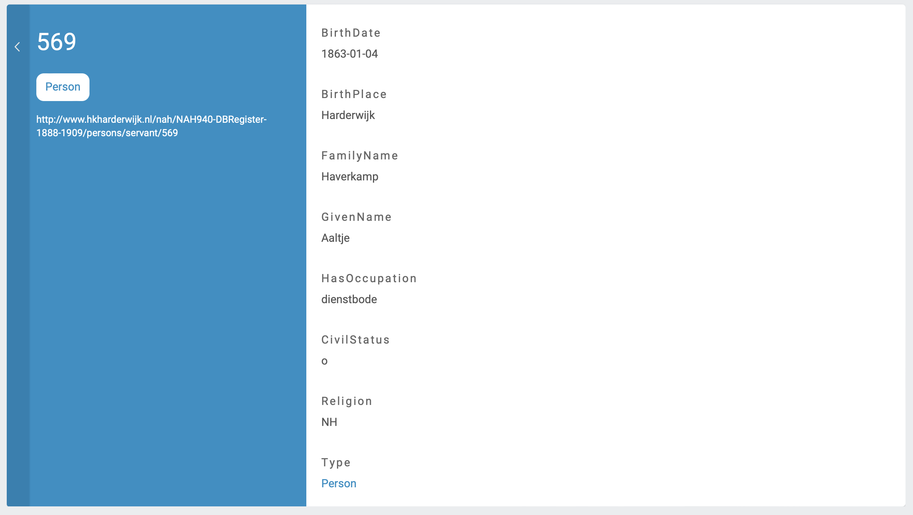

Slide 16
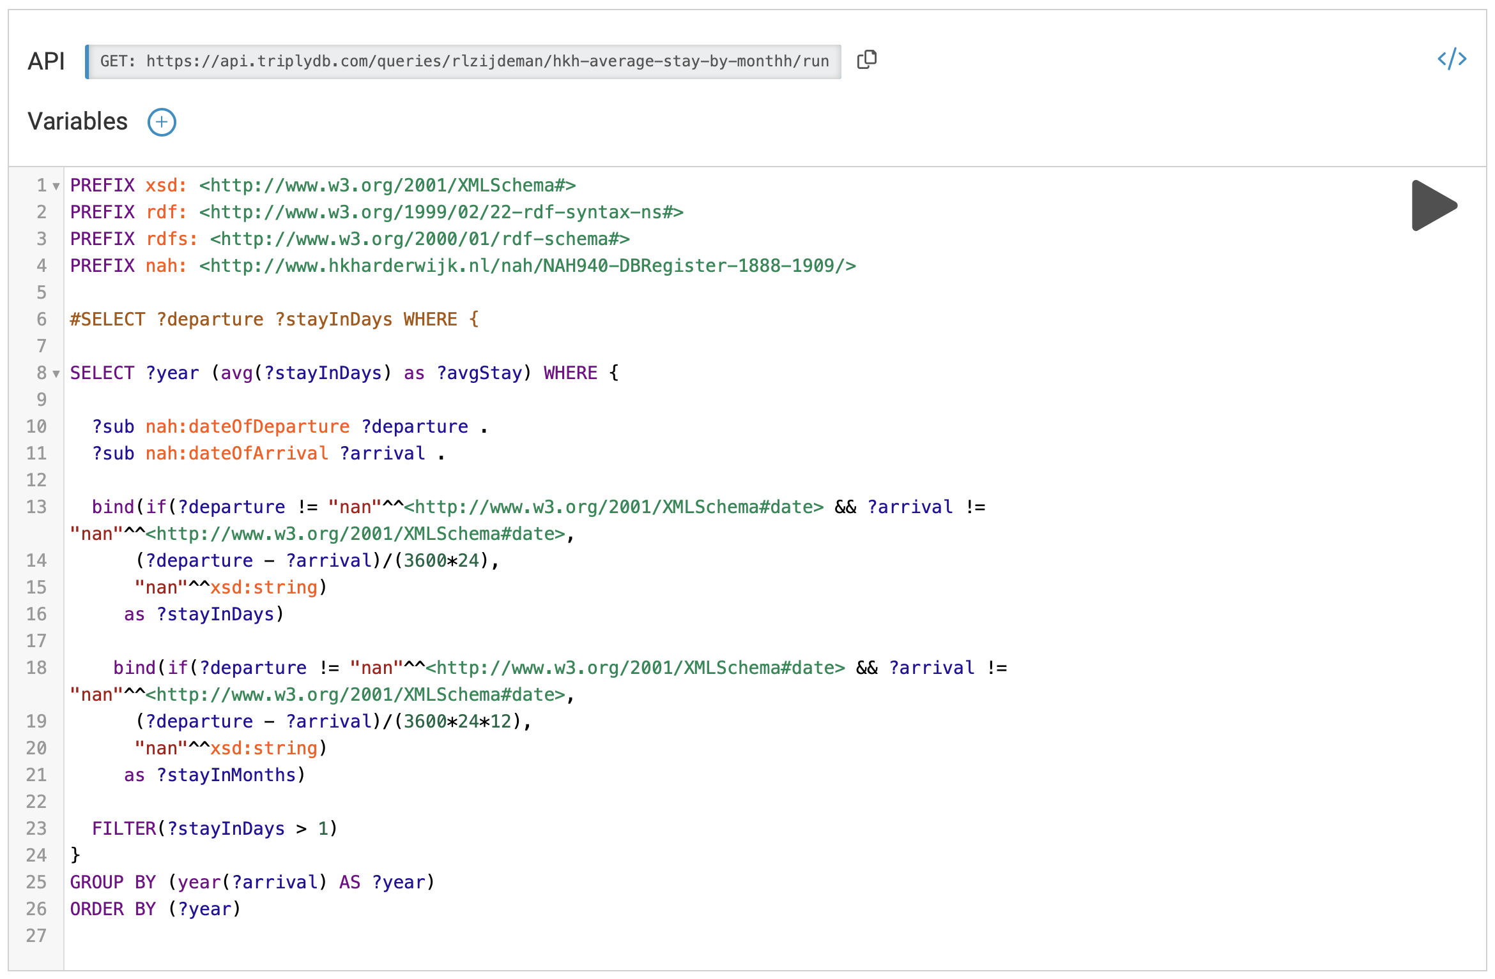
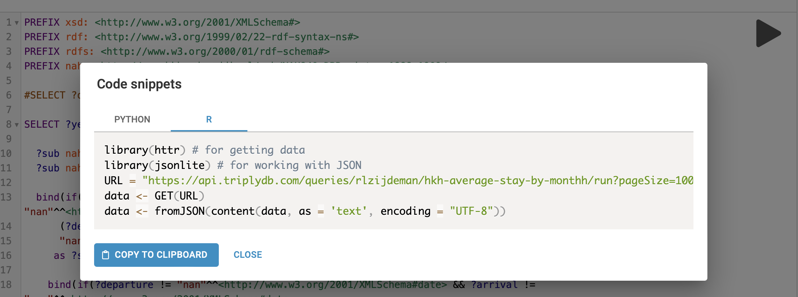

Slide 17
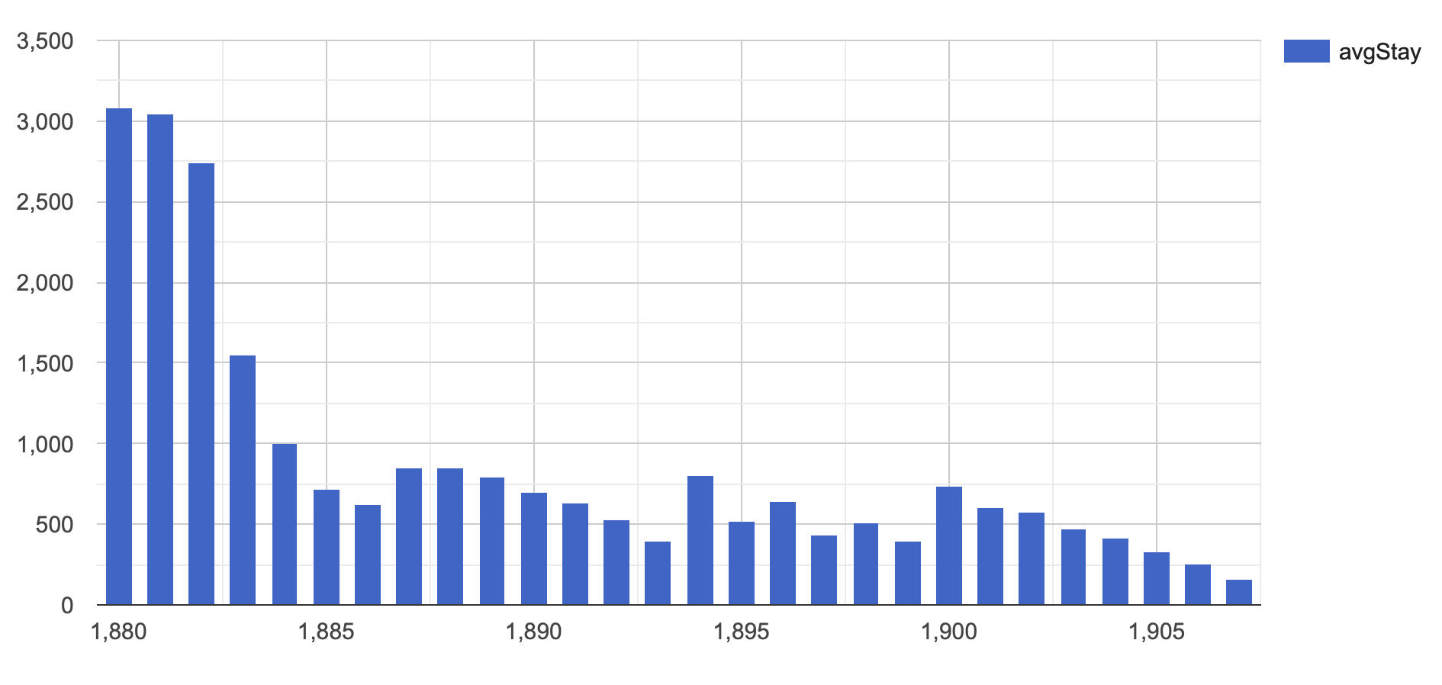
Average stay in days

Slide 18
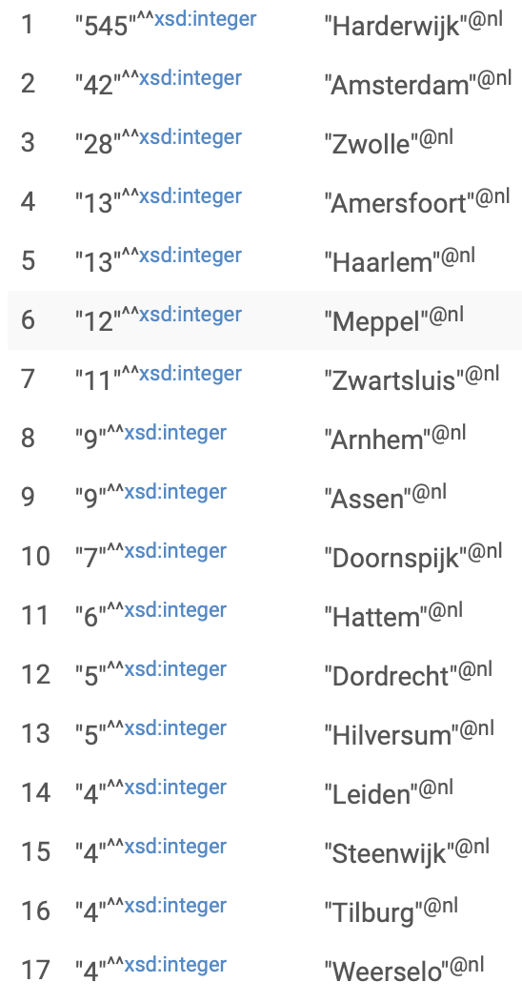
Where were maids born?
Places are provided as strings
Most places are available via DBPedia
So we can query DBPedia for coordinates…
and depict the results

Slide 19
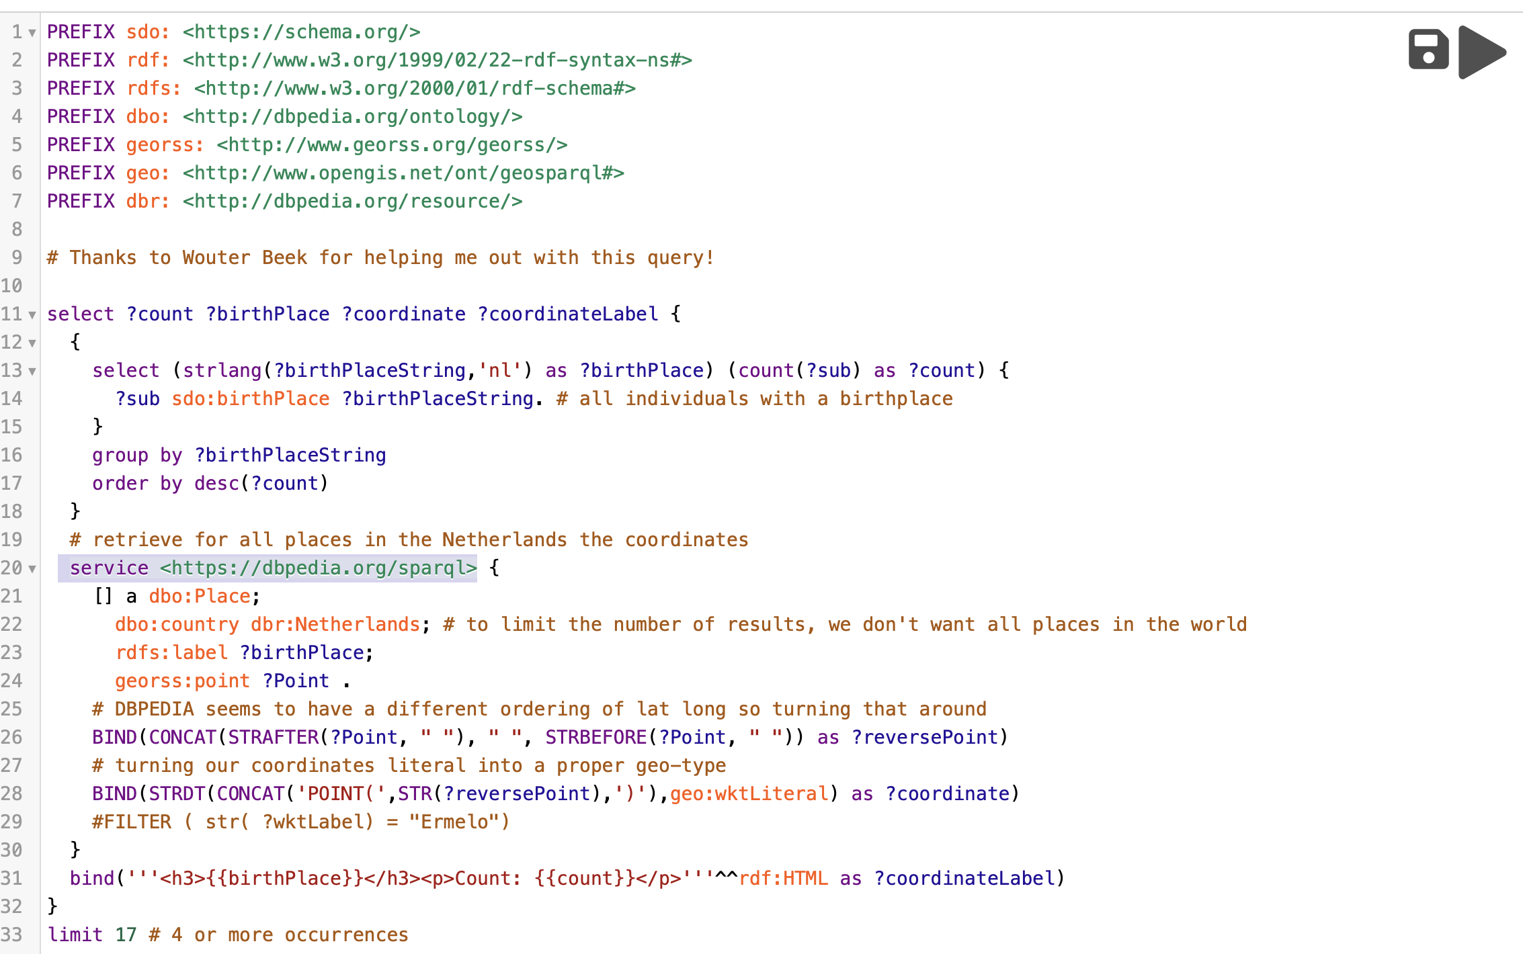
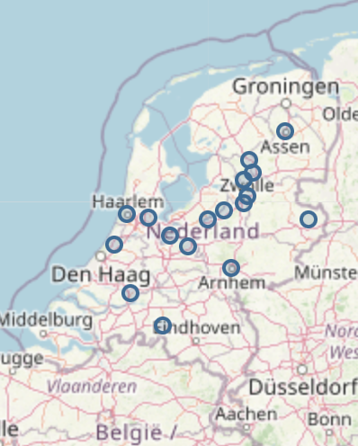
Where were maids born?
Query at: https://triplydb.com/rlzijdeman/-/queries/Query-1/5

Slide 20
WORKFLOW / TOOLS
LDWizard
CSV
to
Linked Data
CoW
HSNDB:LINKS
burgerLinker
Birth
Marriage
Death
druid
Publish Linked Data
Domestic Service Observation
Domestic Service Observation
Domestic Service Observation
grlc.io
Domestic Service Observation
Publish LD Queries

Slide 21
Summary
LINK TO OTHER
DATA TO PROVIDE
CONTEXT
USING W3C STANDARDS
RDF / SPARQL
IN NON-PROPRIETARY
FORMAT
AS MACHINE READABLE
STRUCTURED DATA
PUT IT ON THE WEB

Slide 23
Next steps
Advocate this approach to the NDE (Dutch National Heritage Network)
Enhance sample with (linked) data:
Use burgerLinker to link data to LINKS (civil registers)
Expand to other (Harderwijk) local samples
Also convert other variables (such as religion and occupation)

Slide 24
Been there, done that, bought the T-shirt?
Domestic service work as ‘bridging’ occupation;
Move to urban areas to ‘escape’ rural lower positions;
Acquire knowledge on ways of living of moderate and higher classes;
Gain income for parental household (and reducing cost of extra child);
E.g.: Bras 2003, McBride 1974, Laslett 1965, Fauve-Chamoux & Wall 2012

